Slide 1
CU Off-Campus
An Apartment Search Platform for Columbia Students
see you
Members: Allen Song, Yiwen Fang, Leo Qian

Slide 2
Pain Points in Current Solutions for Off-Campus Housing
Current Solutions | Pain Points
StreetEasy (https://streeteasy.com) | No student-specific reviews No student-specific resources of apartments No quantitative sorting indicators provided, e.g., ratings Scams, sketchy brokers
ForRentUniversity (https://www.forrentuniversity.com/)
OCHA (https://ocha.facilities.columbia.edu)

Slide 3
CU Off-Campus: the Solution
An apartment search platform created exclusively for Columbia students
Reliable insider information sourced from verified Columbia students only
Apartment rating and review system with guides and comments from previous Columbia student tenants

Slide 4
Architecture
Models
Apartment
User
Comment
Views
Apartments
Comments
Sessions
Controllers
Apartments
Comments
Sessions
“Session” is for controlling user’s login, logout, and registration process

Slide 5
Demo

Slide 6
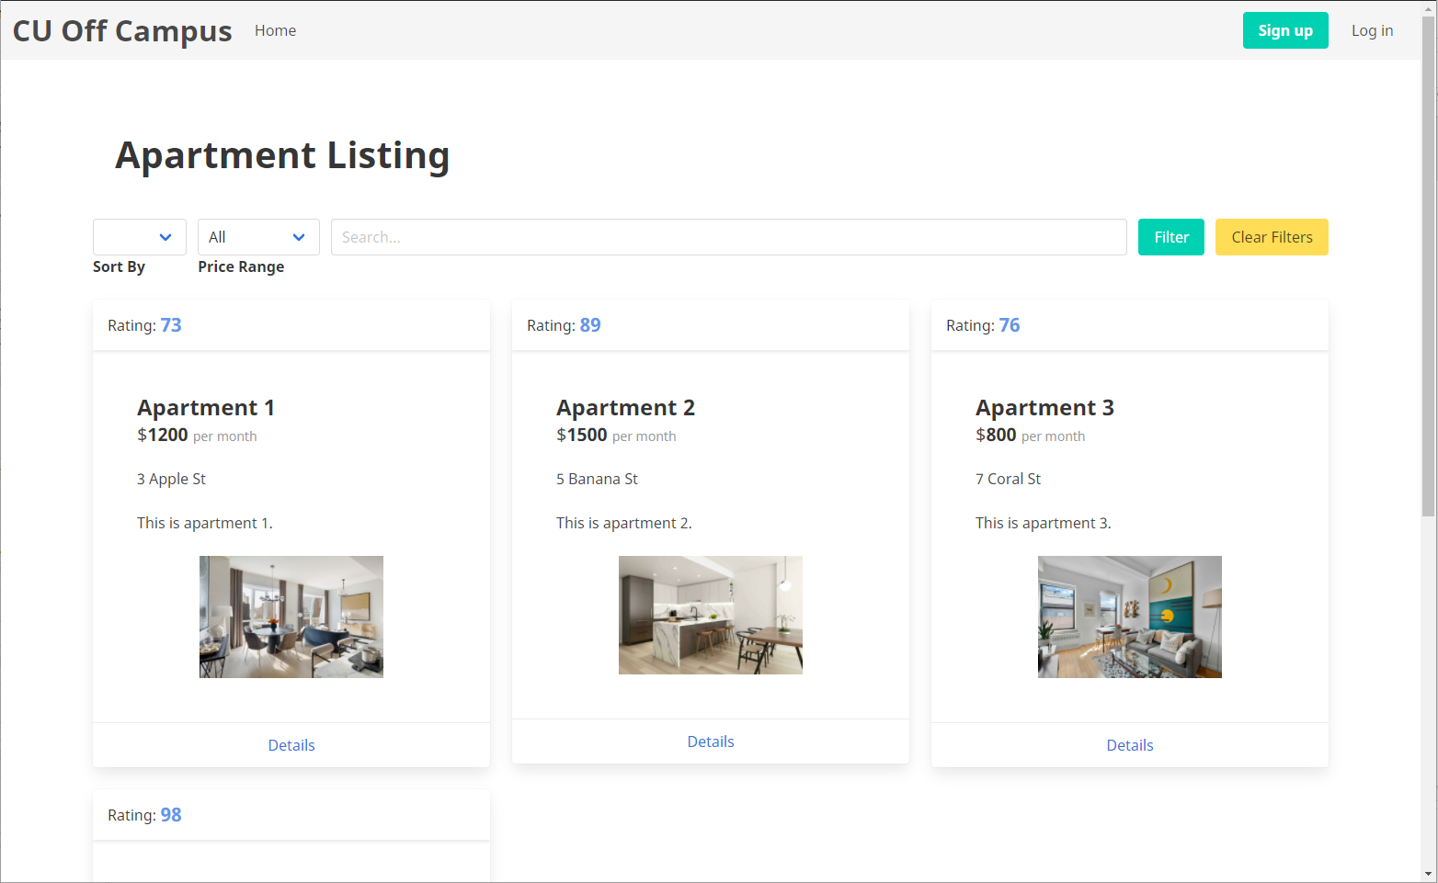
- Website centered around Columbia students.
- Familiar and intuitive interface

Slide 7
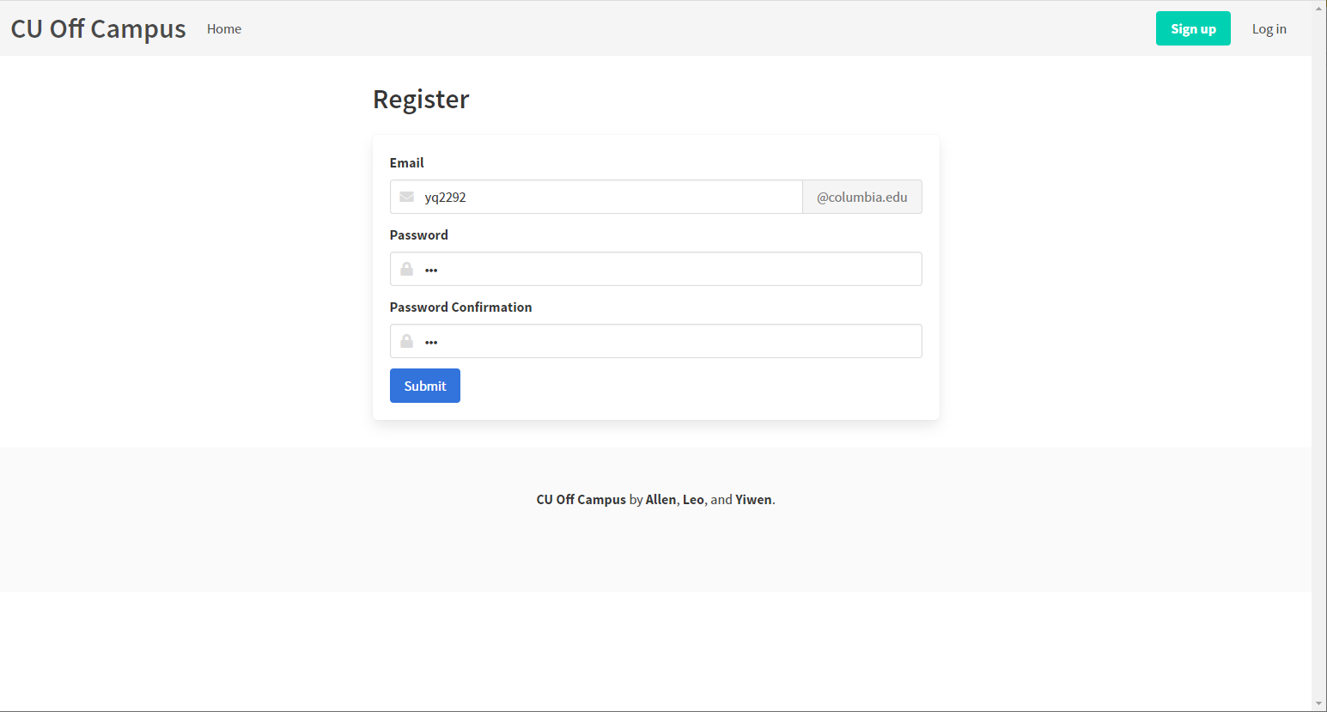
- Sign up with a columbia.edu email (to prevent misinformation from landlords and brokers)

Slide 8
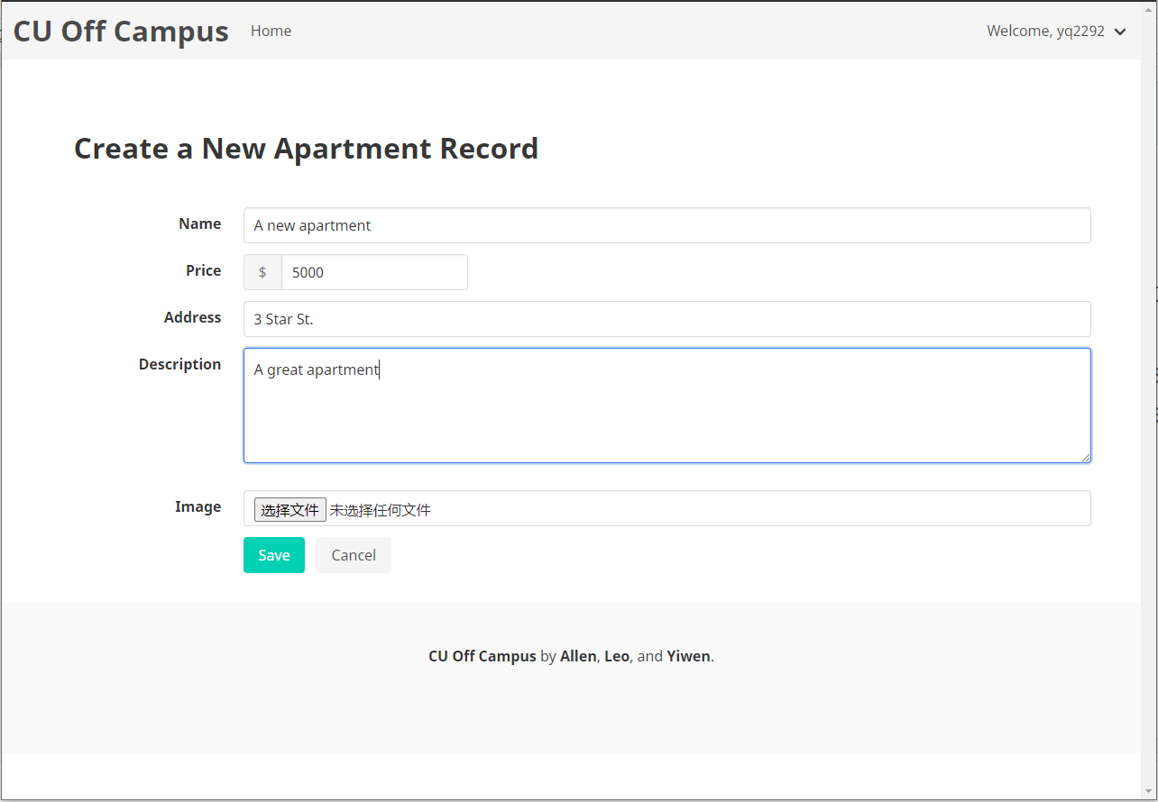
- Add or edit apartments to the resource pool, enabling other students to explore or review the apartment resources.

Slide 9
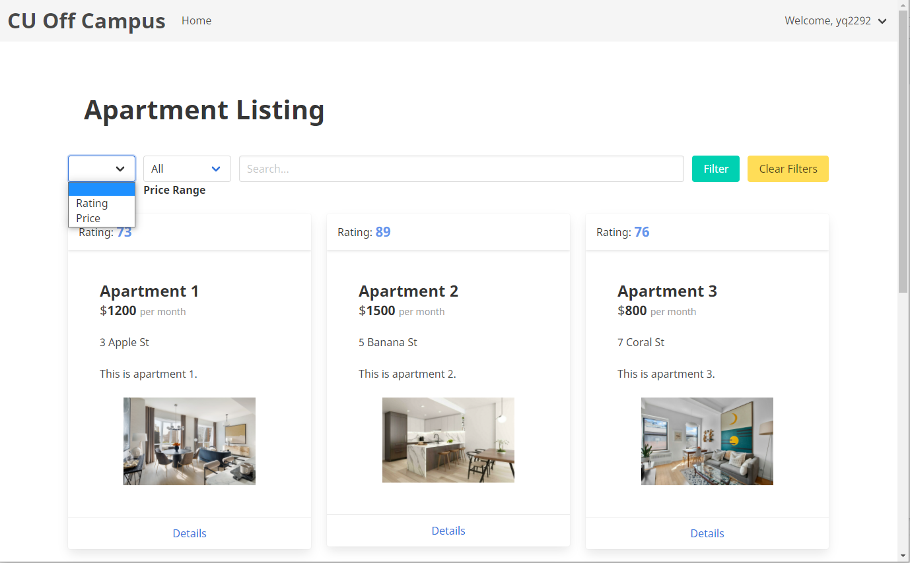
- Quantitative ranked search by desirability according to user search criteria.
- Rankings calculated according to the perspectives of Columbia students and their needs for certain apartment amenities.

Slide 10
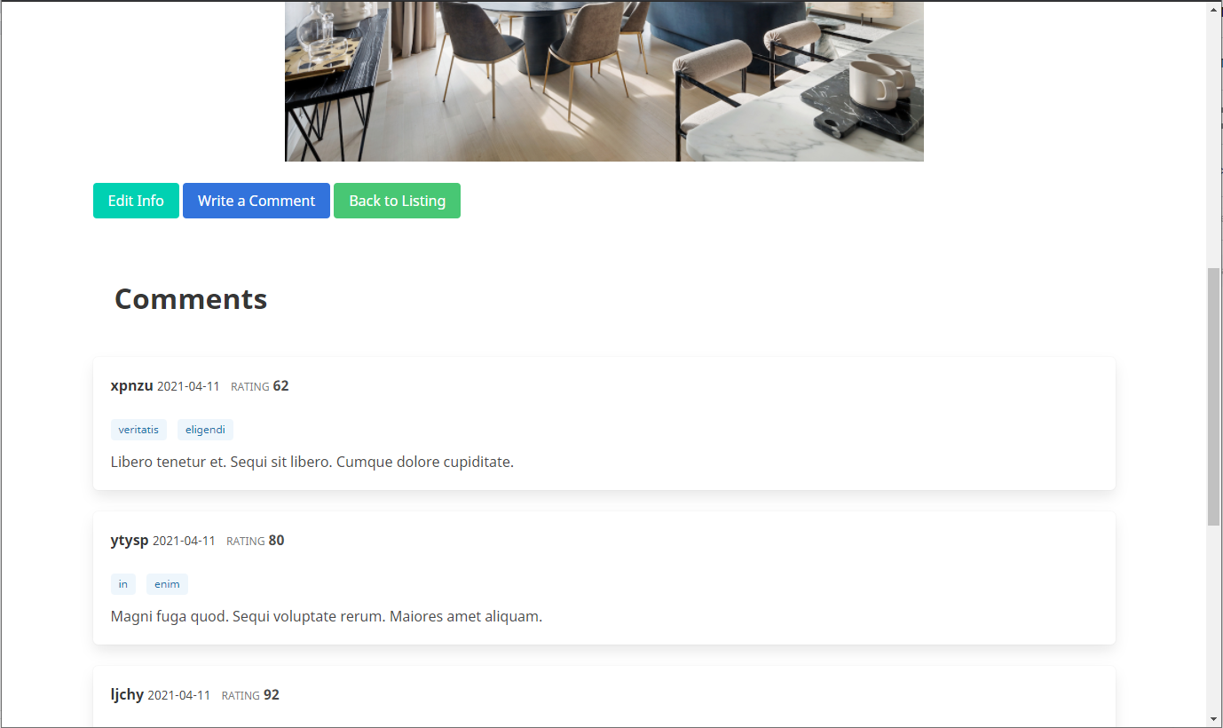
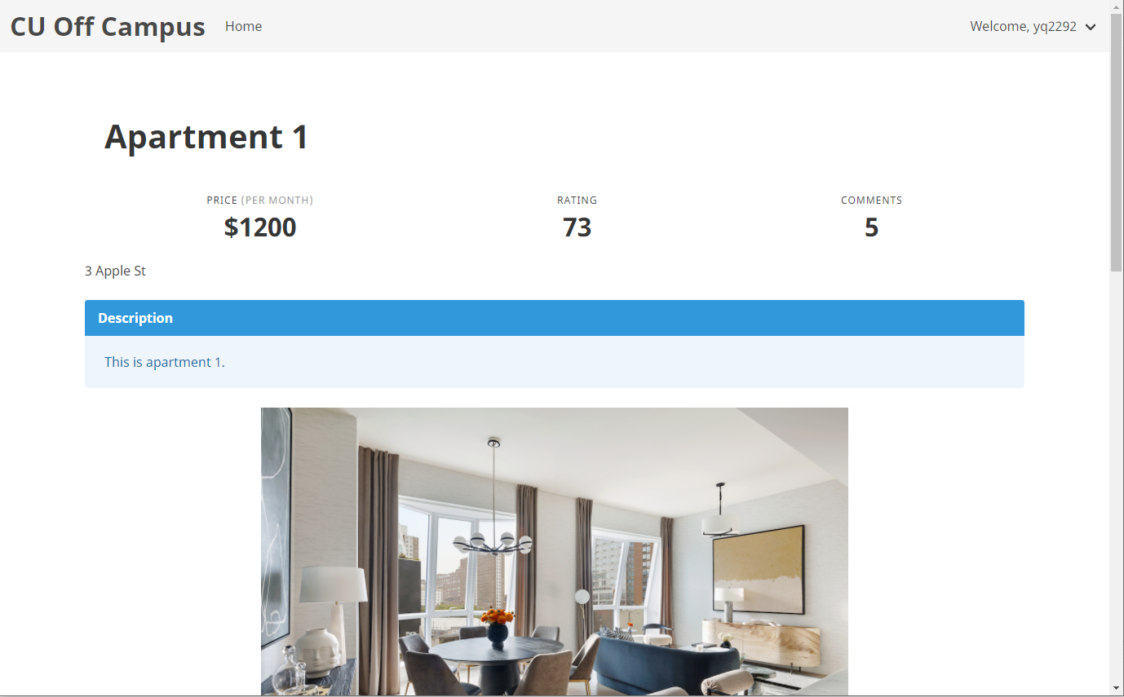
- Normal apartment search website functionalities, with apartment name, price, image, description, and location.
- Rating calculated by the average rating from students’ comments.

Slide 11
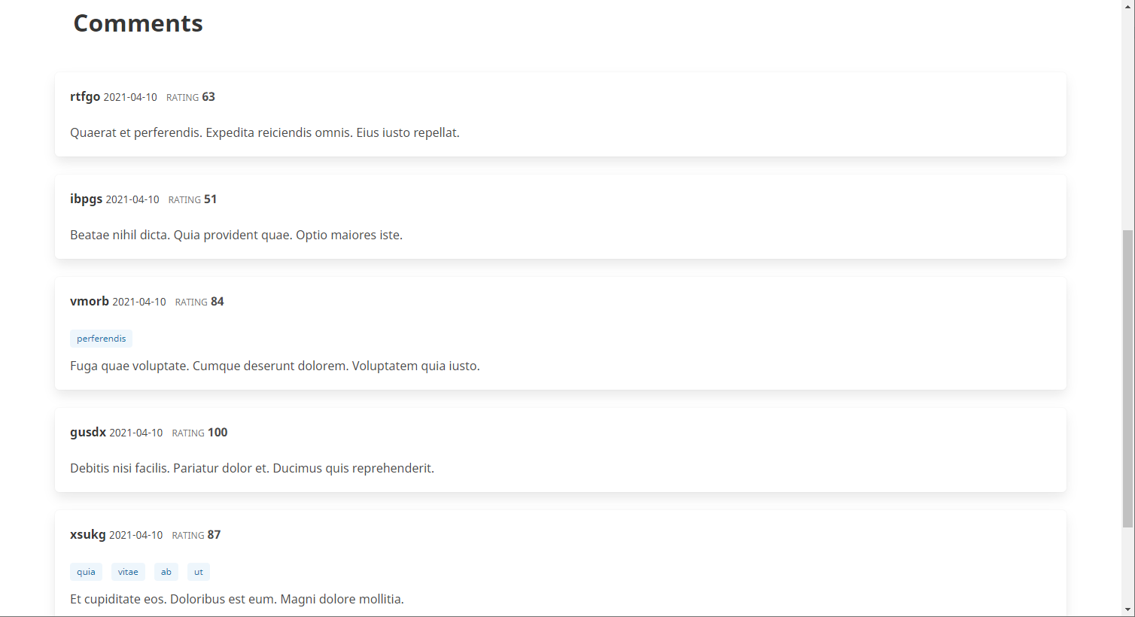
- Comments with rating and tags. Time and username are also shown.

Slide 12
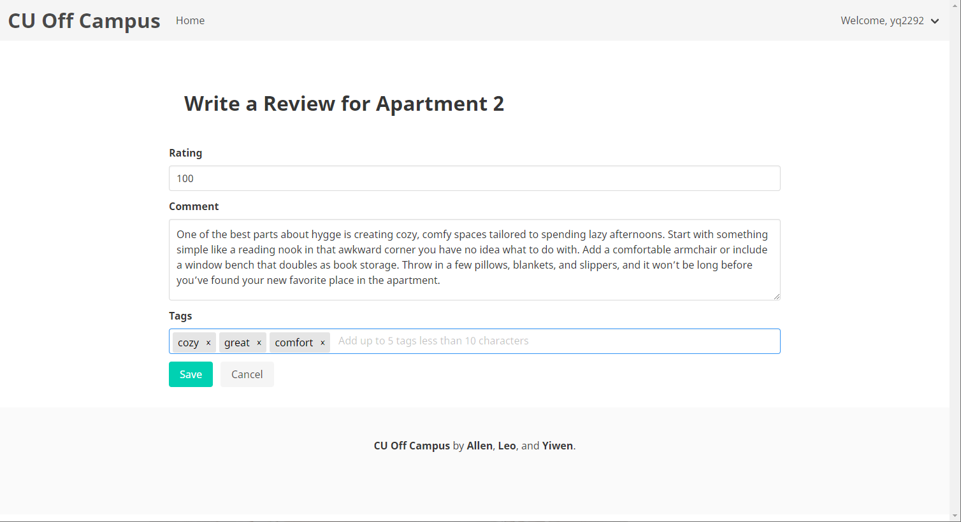
- Write your own comments!
- Attach your own tags!

Slide 13
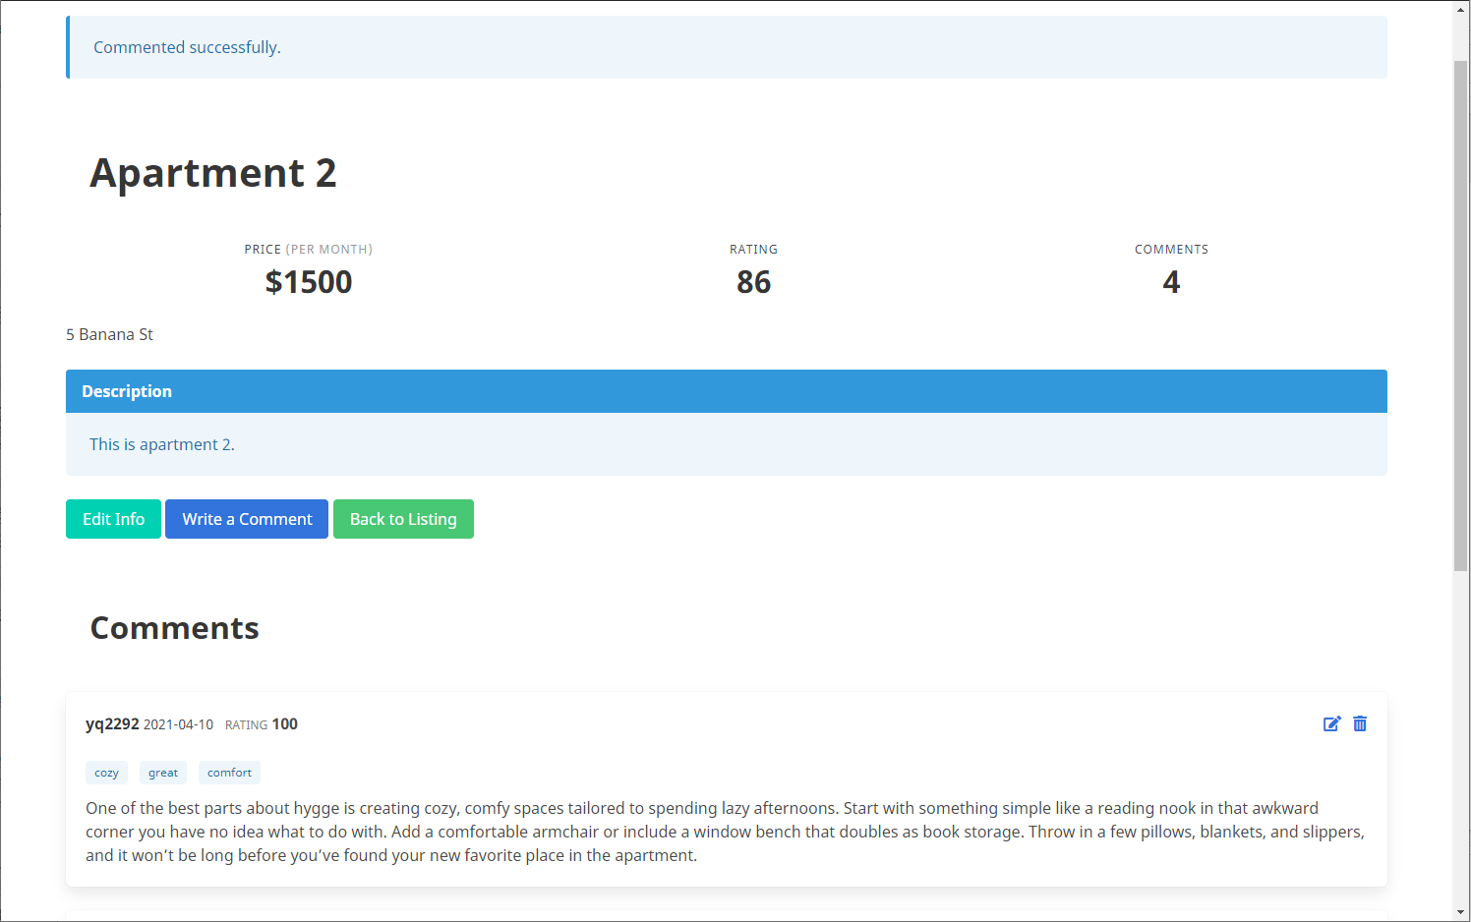
- Your comment will be shown in the comments section. Edit or delete your comment at any time.

Slide 14
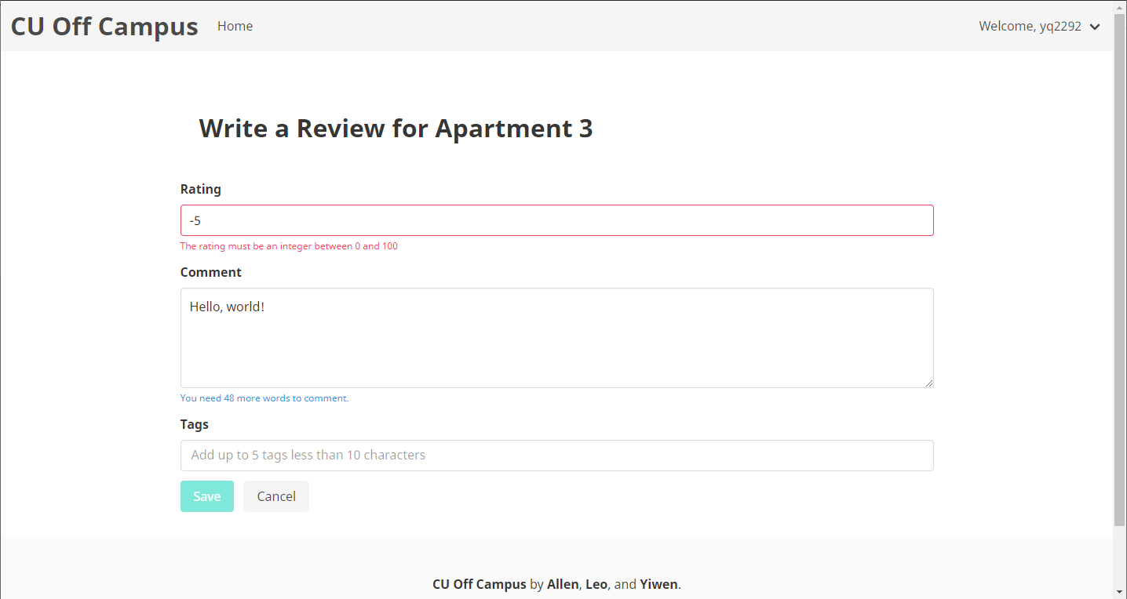
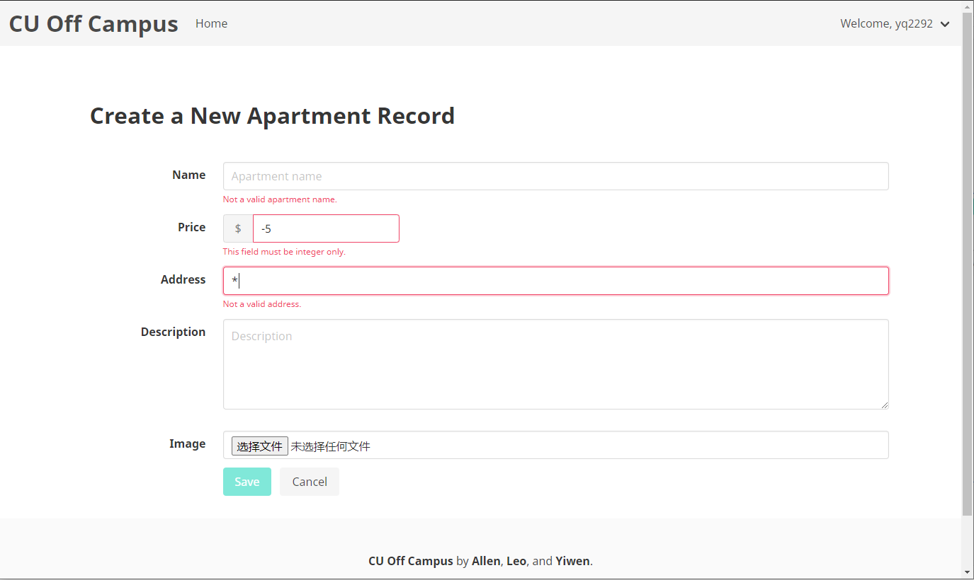
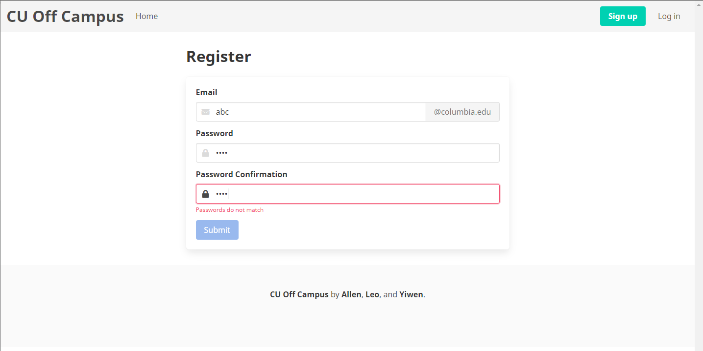
More functionalities
Front-end dynamic field checking

Slide 15
Thank you!

